Slide 1



Group Up
Group 4 Presentation

Slide 2

Motivation and Objective
When our class begins, we are required to find our teammates. It is not uncommon that we tend to naturally group up with someone from the same universities because of familiarity. However, by grouping up like this, we cannot even get to know each other pretty well. Then this idea comes across us: We can design a cloud-based grouping application for this scenario!
We aim to design a system where you can find your teammates based on recommendation!

Slide 3
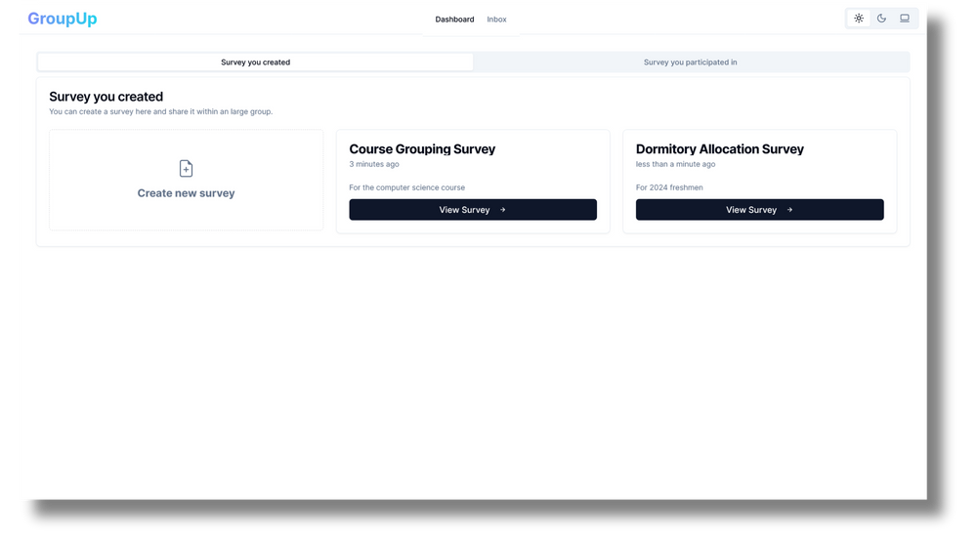
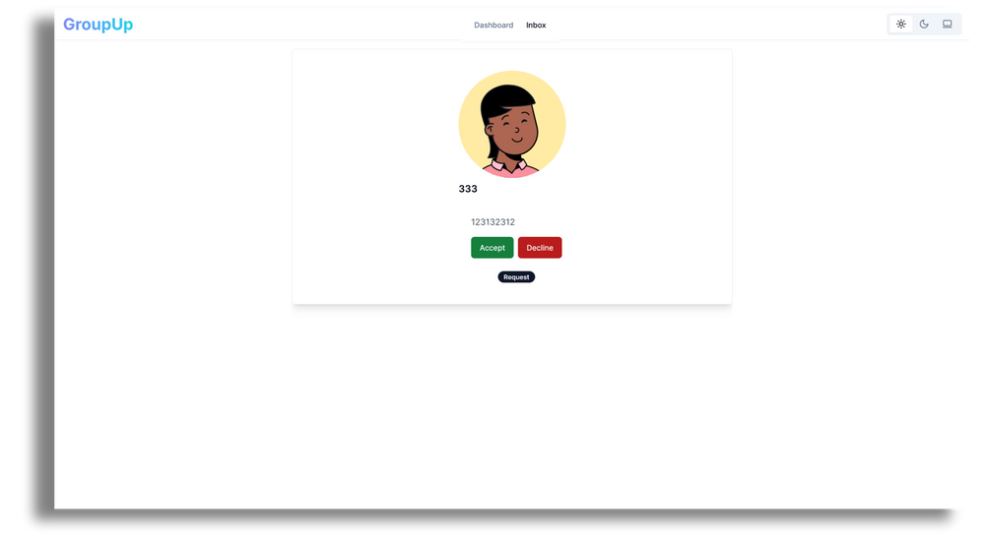
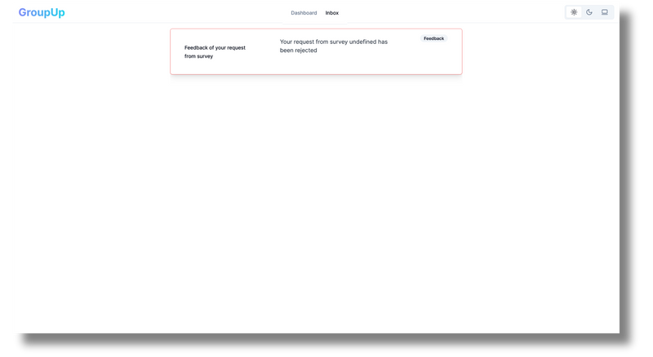

Main Page

Slide 4
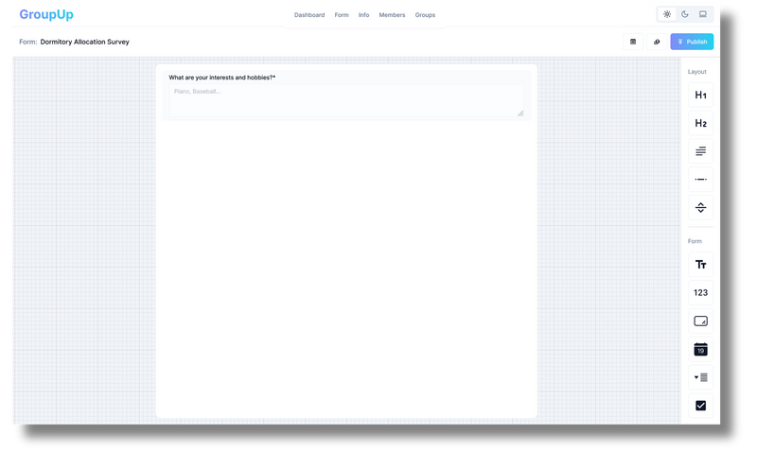

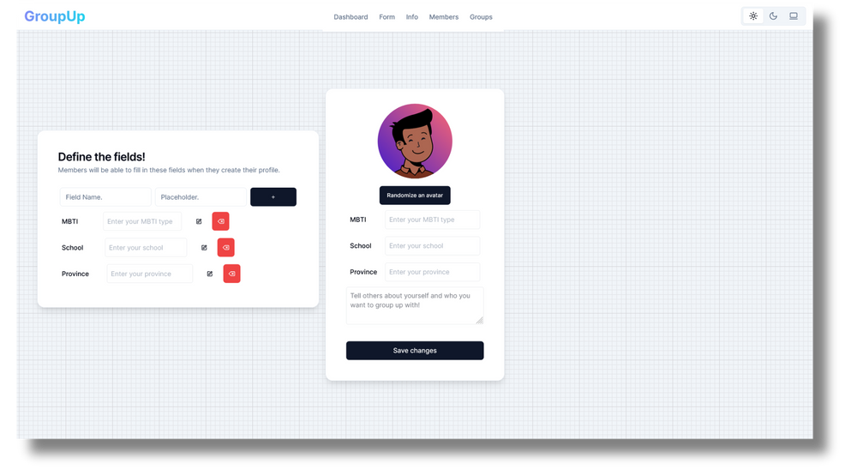
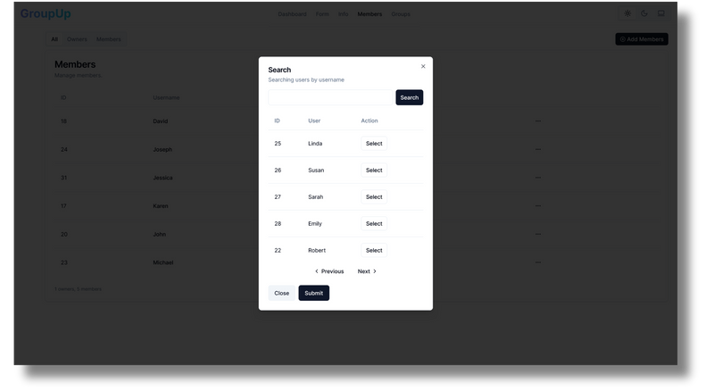
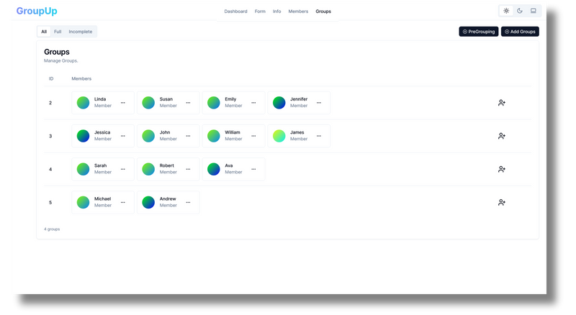
Owner Page

Slide 5
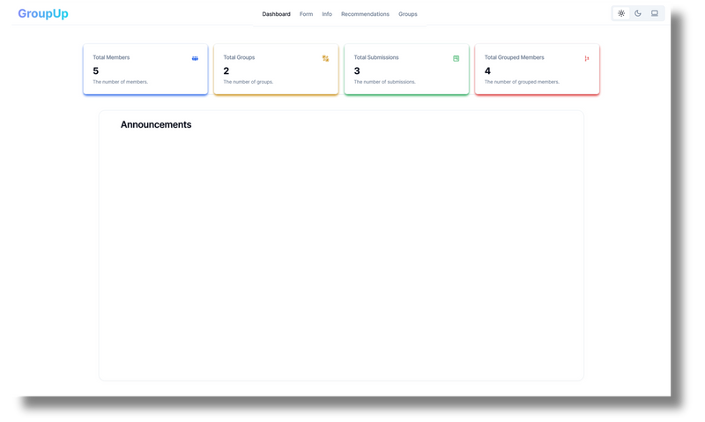
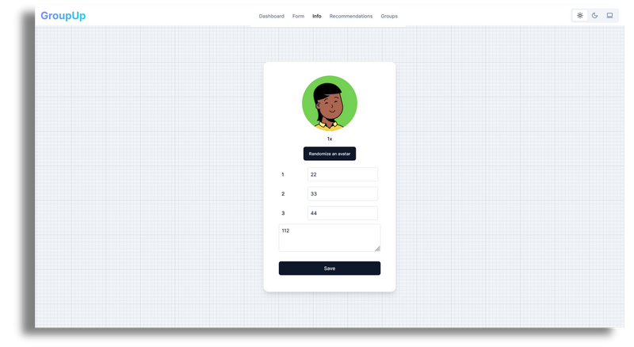
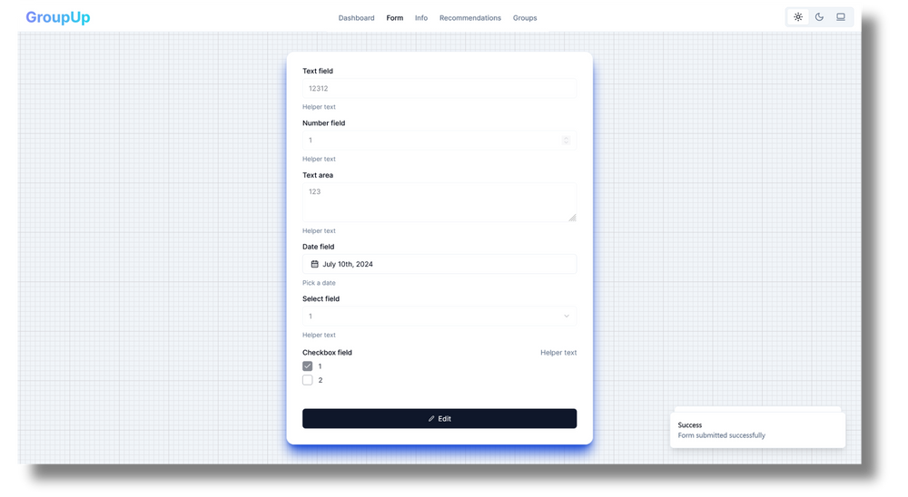

Member Page

Slide 6
Design: Different Stages
Closed
Open
Archived
Create Survey
Modify the questionnaire
Setup restrictions
Add members to the Survey
Not allowed to modify questionnaire
Allowed to publish announcements
Allocate the ungrouped members at one click
Not allowed to modify questionnaire
Allowed to publish announcements
Owners
Allowed to fill in the questionnaire
Allowed to find recommendations in the match ground
Allowed to group up with other member/groups (By sending requests)
Allowed to modify personal info
Not allowed to do any operations, only can check the grouping results and receive announcements.
Unavailable
Members

Slide 7


Recommendation
Leverage the power of LLM
There are two kinds of applications of LLM in our recommendation system. Currently, a LLM model can be divided into encoders and decoders. Users not only fill in the questionnaire, but will also fill in a request for the ideal teammates.
Request for ideal teammates
A model answer for the questionnaire
Quest Embedding
LLM application
LLM Encoders
All other answers for the questionnaires
Match Embeddings
Calculate the distance between quest embedding with other embeddings as recommendation values
LLM Encoders

Slide 8



















Cloud Structure
Distributive Database Service
pvc
Grouping Service
User Service
Survey Service
database
Coordinator
frontend
Authentication
Ingress
Recommendation
database
database
Worker
Worker
database
Message Push
File Transfer

Slide 9
How to divide all-in-one
to micro-service
pvc
All in one first, then micro-service
Functionality first
Simple for monolithic structure
then use microservices to improve
Robustness
Scalability
Performance
Trouble in communication
Call other service -> HTTP request to others
Communicate with database -> database as a service

Slide 10
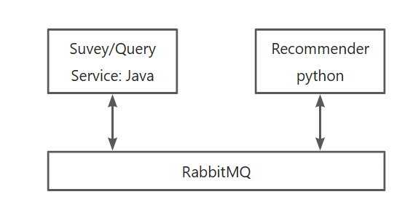
How to divide all-in-one
to micro-service
pvc
RabbitMQ: Run after response, improve vectorizing speed
Vectorizing is time consuming
Create and store vector before call
Submit tasks: rabbitMQ

Slide 11
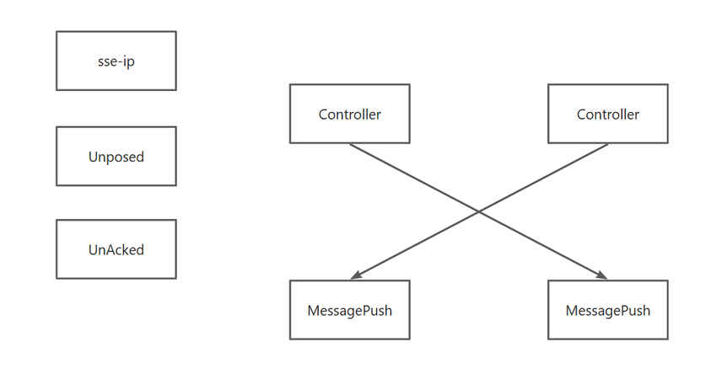
How to divide all-in-one
to micro-service
pvc
SSE instead of polling
HTTP response only after request
SSE technology to push message to server instead
Special design

Slide 12
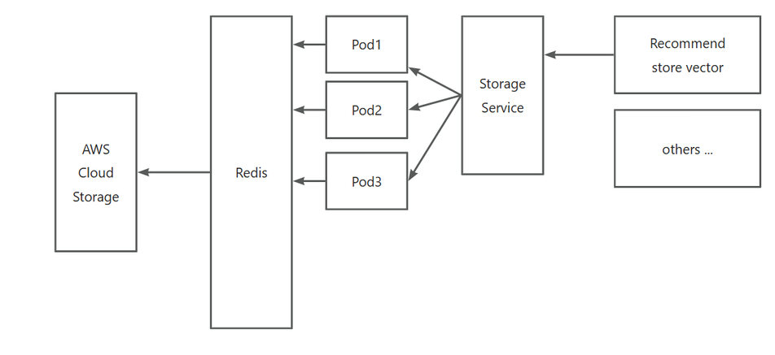
How to divide all-in-one
to micro-service
pvc
Cloud Storage AWS
AWS Cloud storage is
robustness
High scalability
But time consuming while connection
Redis for cache
High performance k-v database

Slide 13
How to divide all-in-one
to micro-service
pvc
Data warehouse and database
OLAP vs OLTP
Use Spring-batch:
Update data warehouse data from database periodically

Slide 14
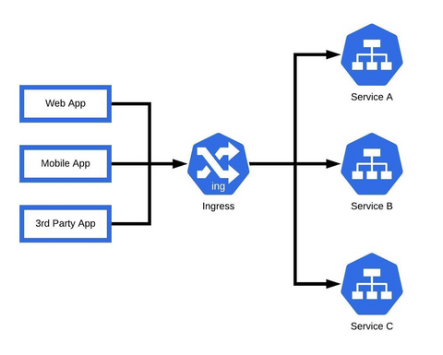
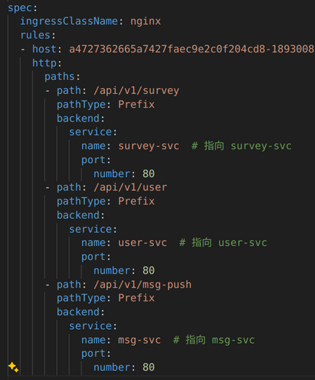
Unified Entry Of Backend
Ingress
Path-based routing
allowing traffic to be directed to different services based on the URL path
LoadBalancer Service:
distributing incoming traffic evenly across multiple pods of backend services, improving reliability and performance.
Authentication & Authorization:

Slide 15
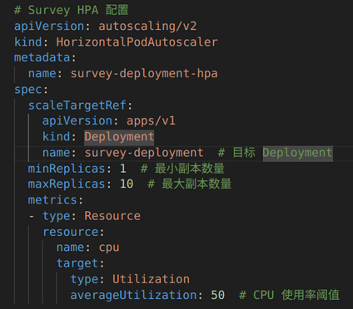
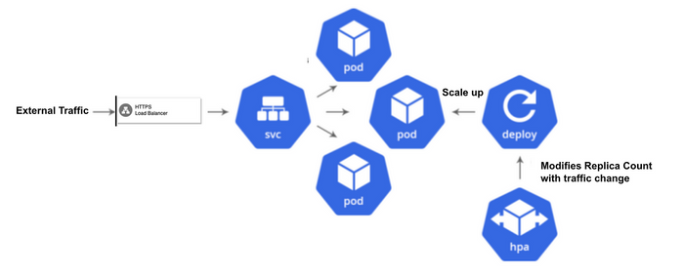
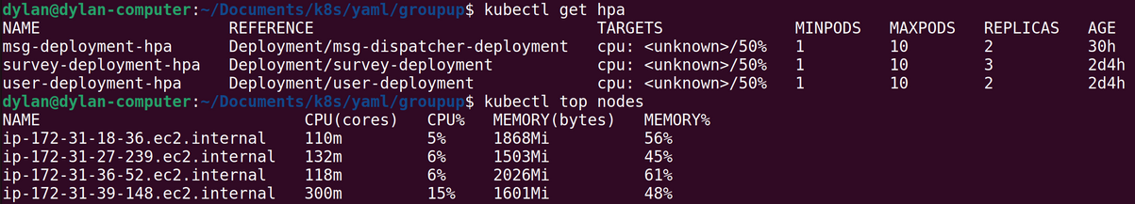
HPA
Automatic Scaling By Custom Metrics Support
efficient, responsive, and cost-effective application management.

Slide 16
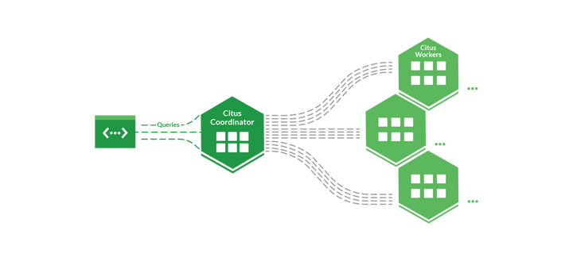
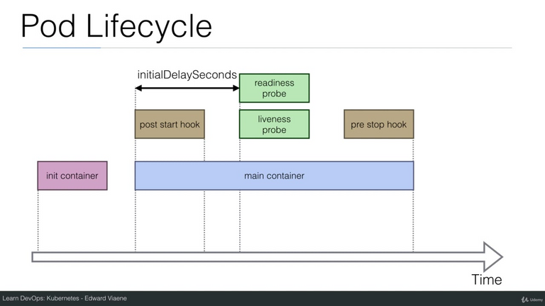
Citus-cluster
Citus
Distributed Database Service. Multiple pods work together in a distributed manner to support high-speed query of data
Initial Container
using secret to record database password
Using initial-Container to set worker nodes for coordinator and create database tables at the first time.

Slide 17
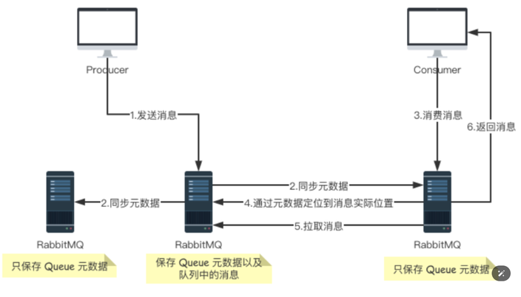
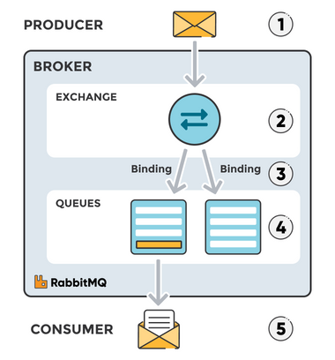
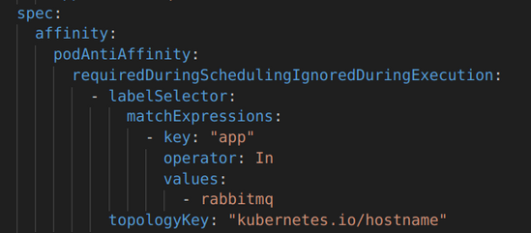
RabbitMQ-cluster
Mirror Message Queue
Deploy mirror message queue services on multiple nodes according to the Pod Anti Affinity policy so that back-end services from any node can quickly obtain messages.
PodAntiAffinity
ensures high availability and fault tolerance by preventing pods with same labels from being scheduled on the same node, thereby reducing the risk of simultaneous failures and efficiency.

Slide 18
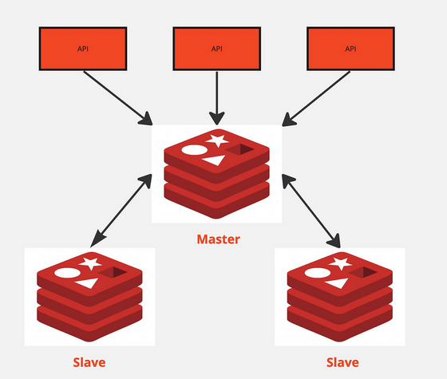
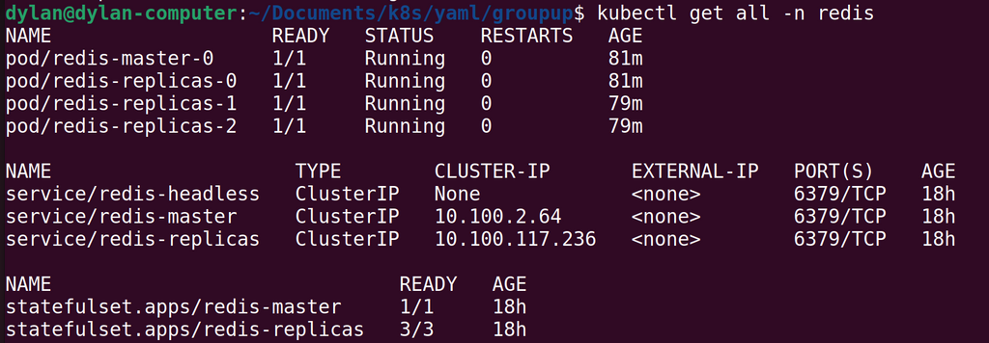
Redis-cluster
Cache Storage
implementing public cache storage between multiple pods, improves the efficiency of commonly used data acquisition, and solves the problem of slow storage acquisition from cloud services.

Slide 19
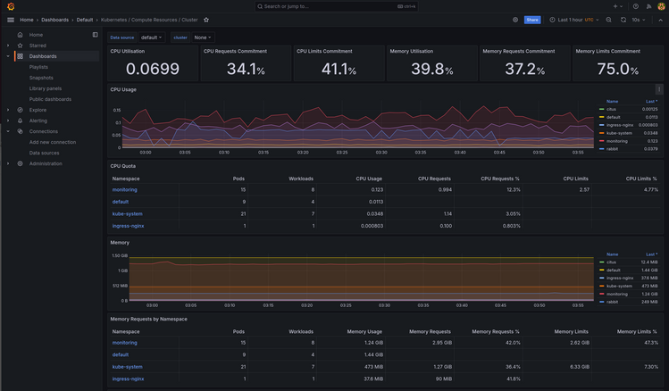
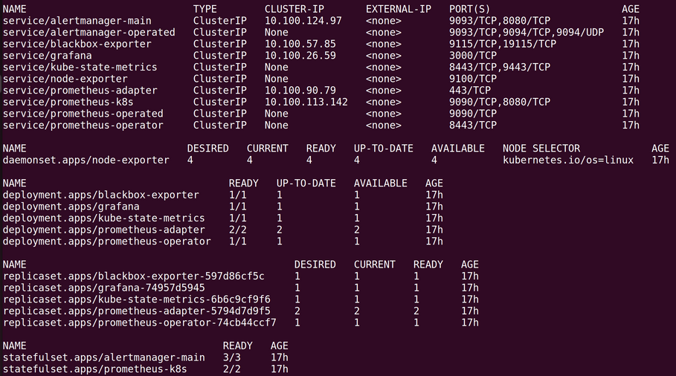
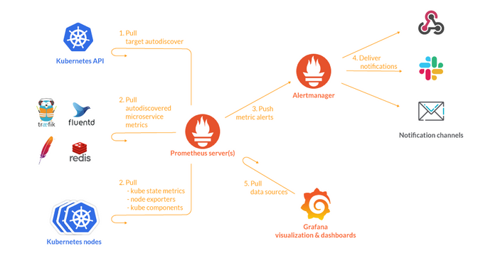
Kube-Prometheus
Preconfigured Grafana Dashboards
Intuitive interface provides convenience for operation and maintenance personnel
Customized Alerting Rules
customized mechanism to facilitate operation and maintenance personnel to respond quickly to special situations.

Slide 20
What is good for k8s
Robustness
Easy deployment and management
CI/CD (Continuous Integration and Continuous Delivery/continuous)
pvc

Slide 21
Thank you!

